Slide 1
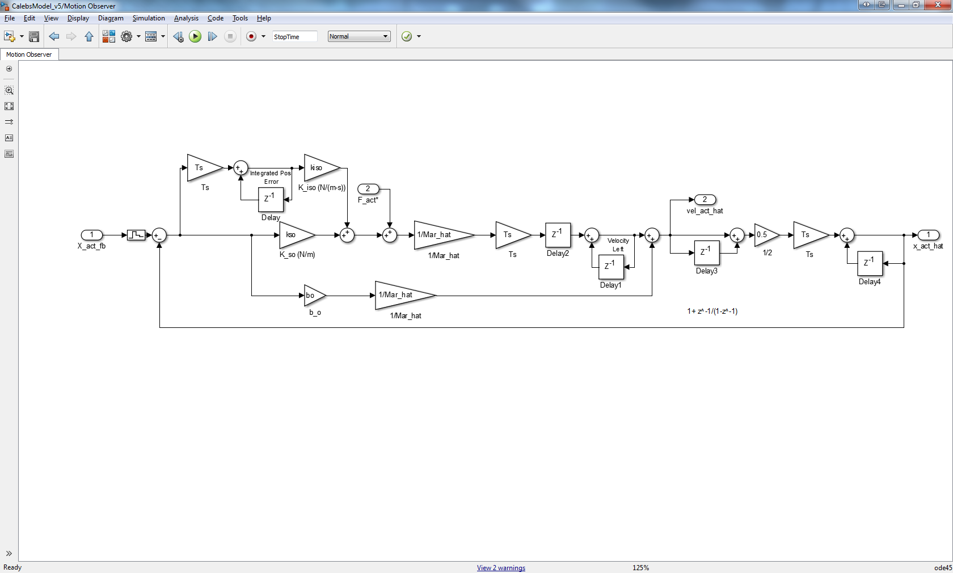
int Xerr
*Just the history
gets used?*
Vunkn
Vleft
Vhat
Xmeas_hat
int Xerr hist
Xmeas
Xmeas_hat
Vunkn hist
Xmeas_hat hist
Vhat hist
Xmeas_hat hist
Vleft hist

